Slide 1

Design and Implementation of Mobile Applications
Oleggo
Falci Angelo
Gallego Julian
Teacher: Baresi Franco

Slide 2
What is Oleggo?
Oleggo allows to create a own personal library with all book we are reading or we have read with notes connected to each book and with personal dictionary that save all words that we search directly in Oleggo.

Slide 3
Why use Oleggo?
Mainly because we can have always with us our notes and because we can insert notes and search the meaning of the words in a fast way using the speech recognize.
Moreover for each book we are reading we can save and update a bookmark.

Slide 4
How use Oleggo?
The application is very intuitive to use thank to the side menu at the left of the page that allow to move quickly between the different main pages.

Slide 5
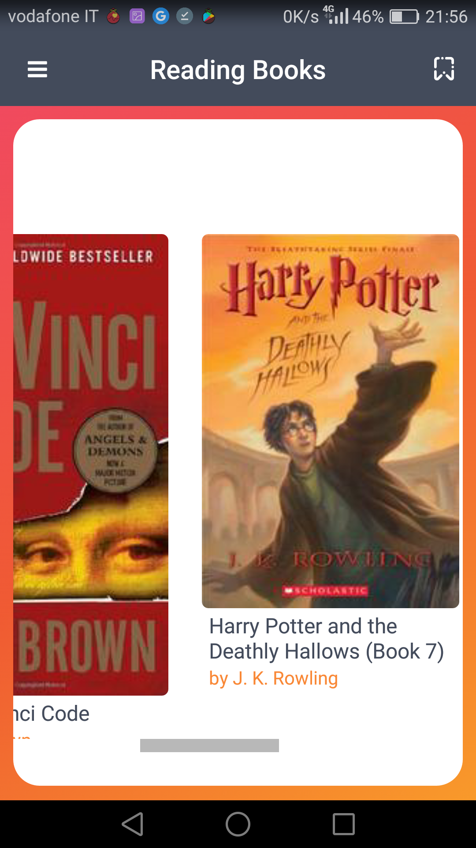
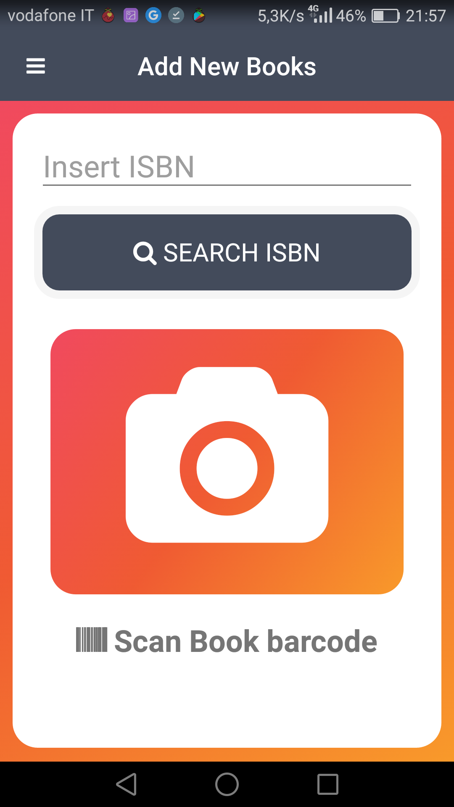
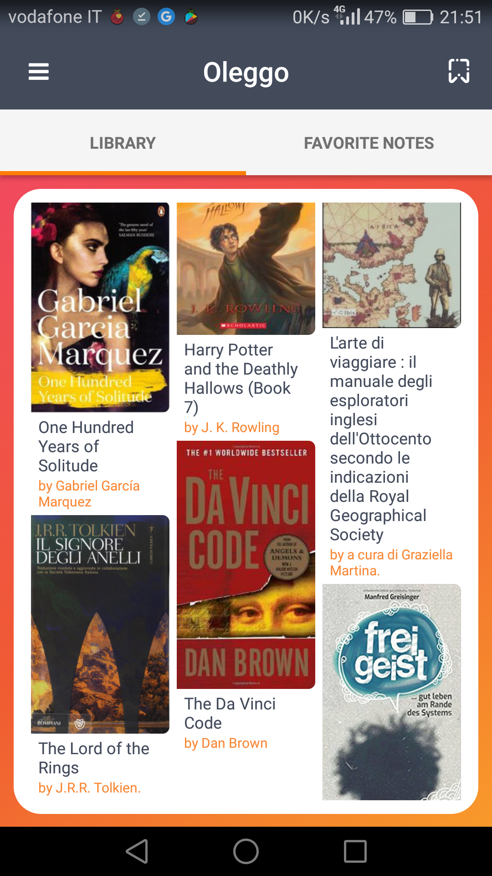
You can add more books

Slide 6
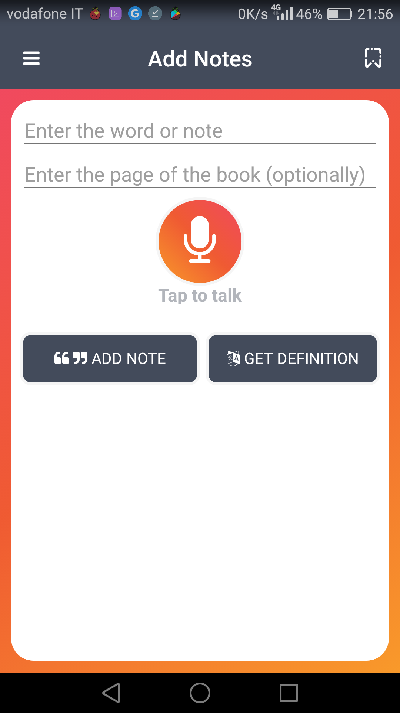
You can insert notes or look for a word

Slide 7
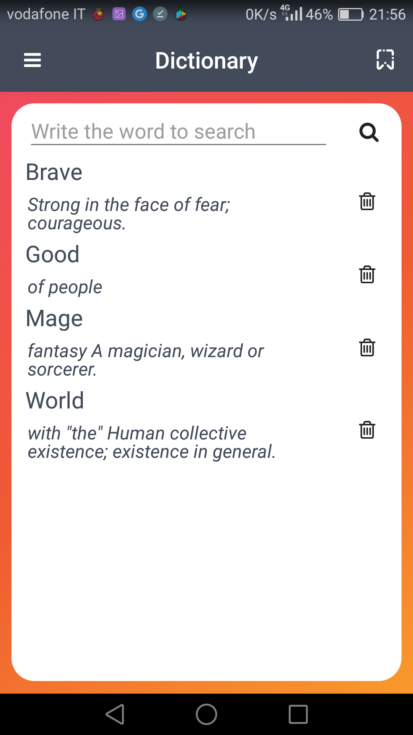
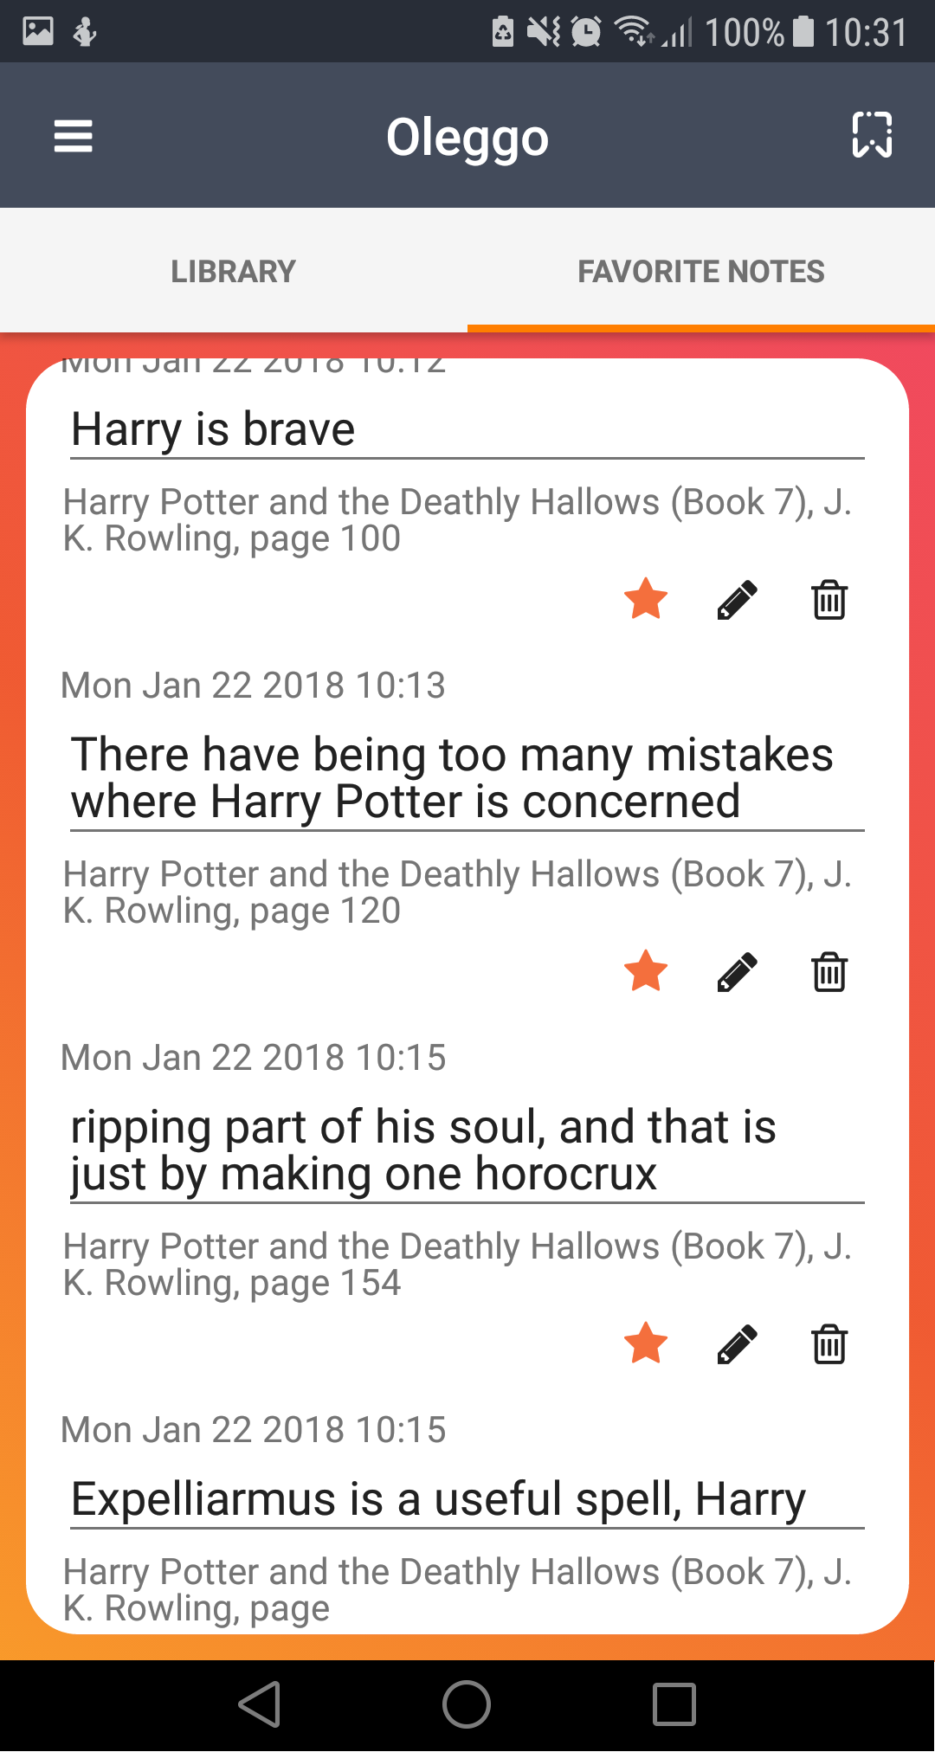
And see what you added

Slide 8
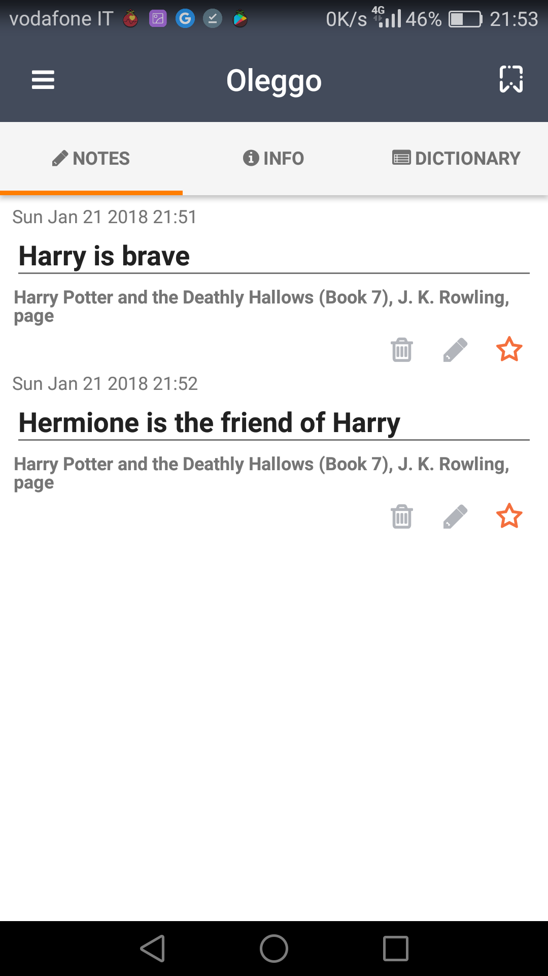
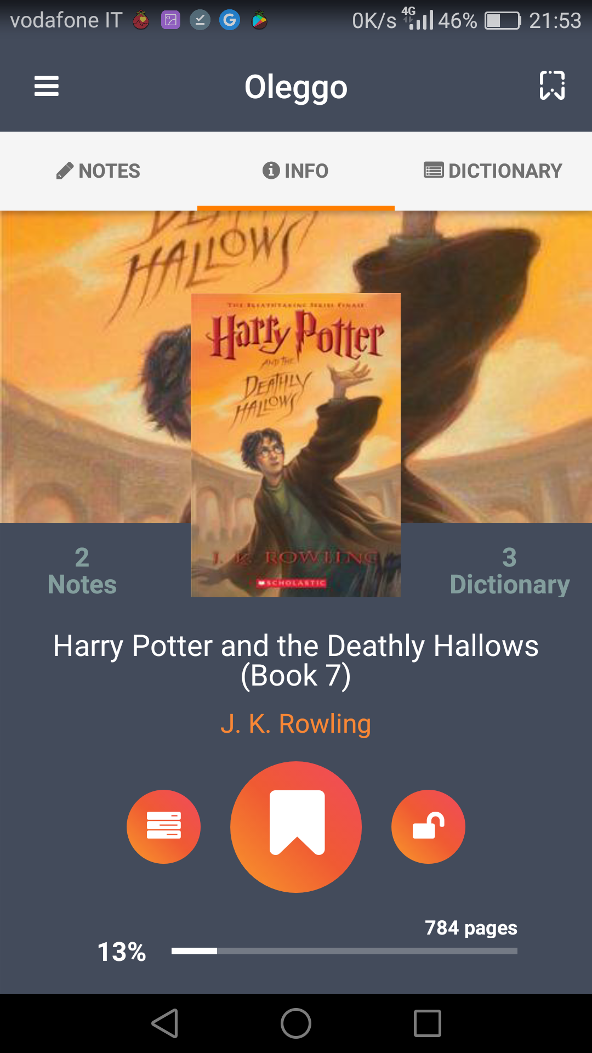
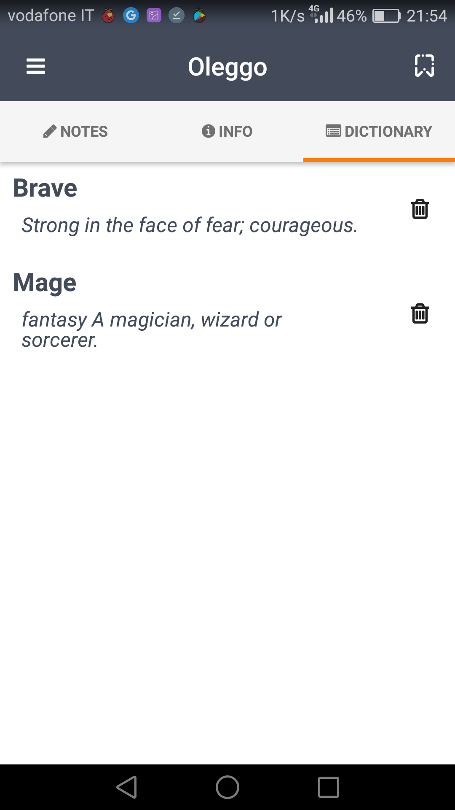
Link books with notes and words

Slide 9

External Services
API to look for information about books using ISBN
API to search the meanig of a word

Slide 10
Threads Used
The call to the dabase are done in asynchronous way from the main process using a system called "promise".
In this way eventually slowdowns coused by database not influence the application.
Using it the pages is upload immediately and data after.

Slide 11

Thanks for your attention!

